Slide 1
M. S. ENGINEERS AHMEDABAD 09327062970
ABOUT US
MANUFACTURE OF RUBBER PARTS, ANTI VIBRATION MACHINE MOUNTS, POLYURETHANE PRODUCTS, Since Last more than 3+ Decades having a dominant name in market for Quality products, Supply of Products on Time and supplying to all OEM Machine Manufacture All over the india We have some of the OEM Suppliers in our list since More than 26+ Years , We have a huge Range of Anti Vibration Machine Mounts around 27+ Types of Mounting pads are available in ready stock And Rubber products such as RUBBER GASKET for OIL TANK , RUBBER HOSE CLAMP, RUBBER BUSH , O- Mounts all Rubber Products are also available in plethora of sizes and Other sizes can also be Manufactured as per Your Design and Requirement Do contact us for Any RUBBER , POLYURETHANE, NYLON, WOOLEN FELT products We are the Manufacture of this Product M- 09327062970

Slide 2
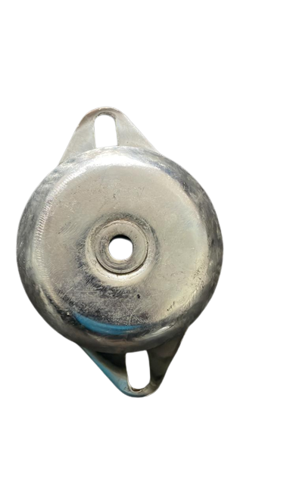
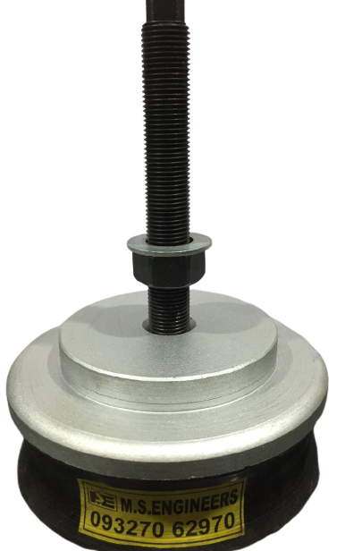
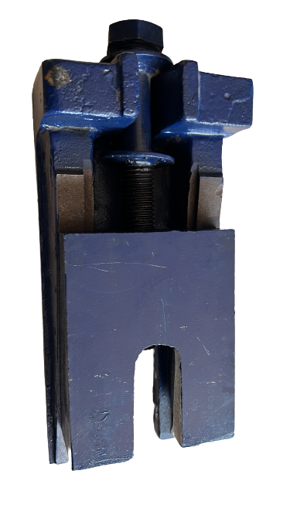
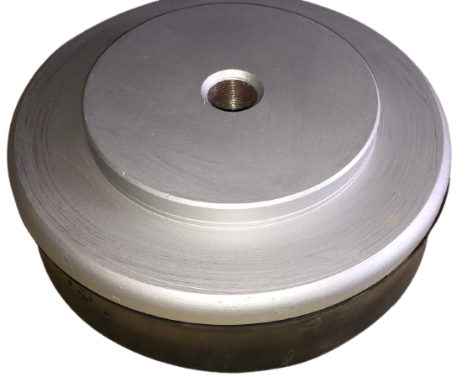
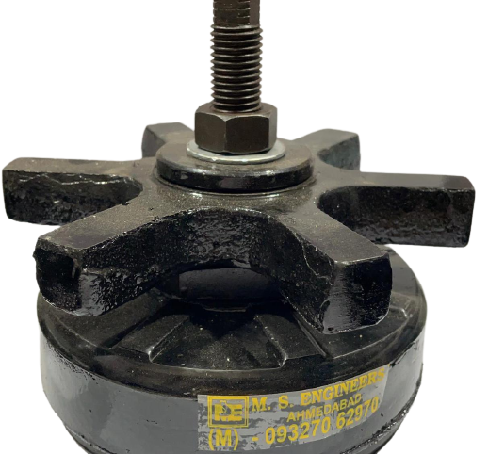
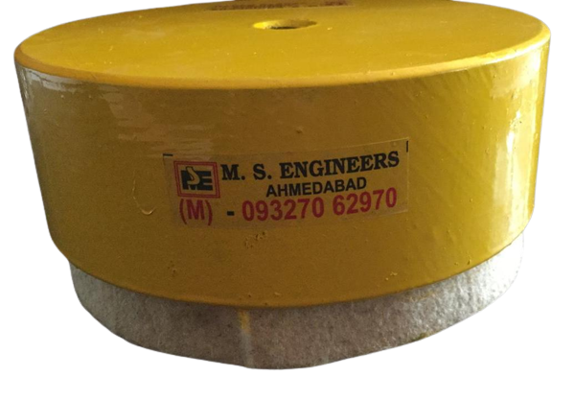
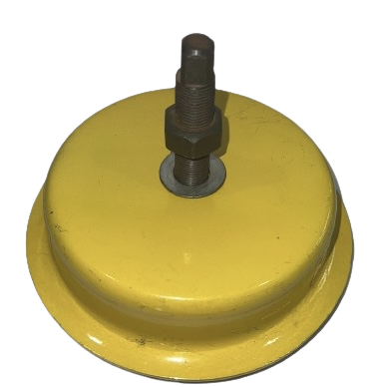
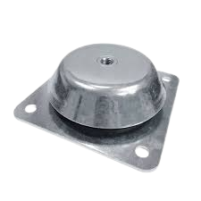
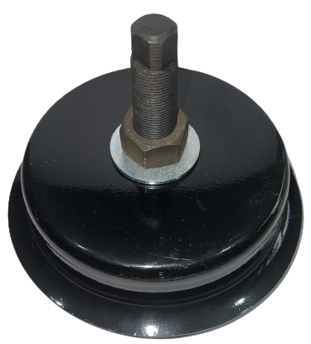
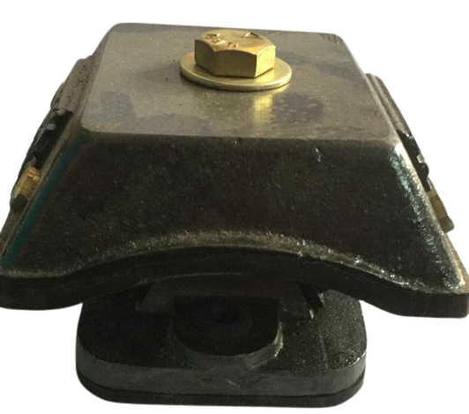
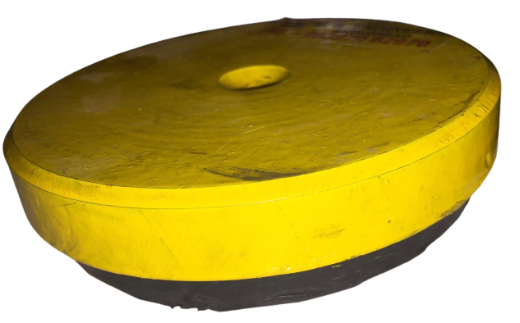
ANTI VIBRATION /
LEVELLING PADS & MACHINE / BASE MOUNTS

Slide 3
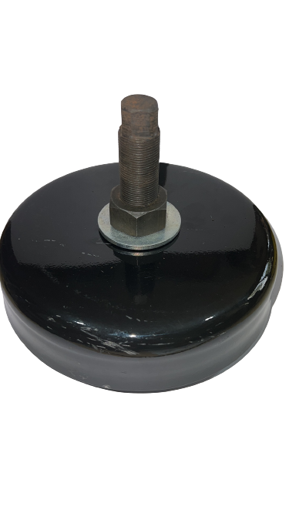
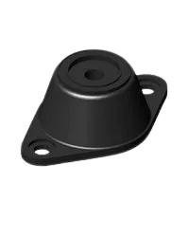
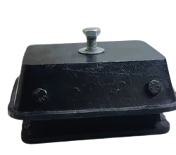
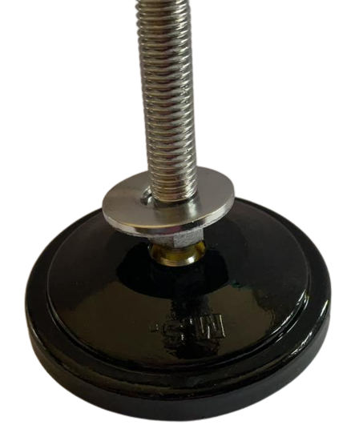
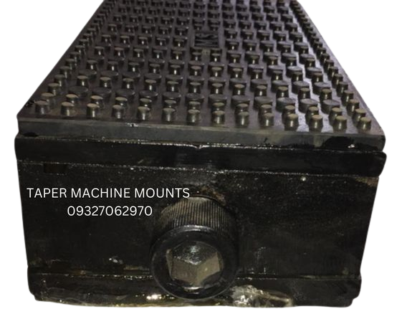
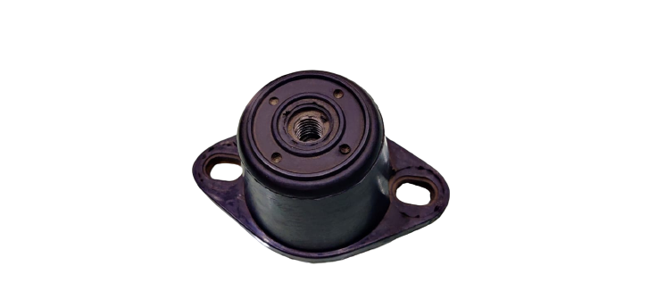
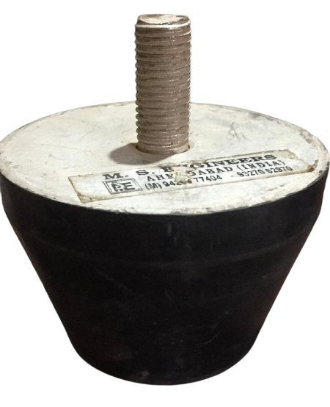
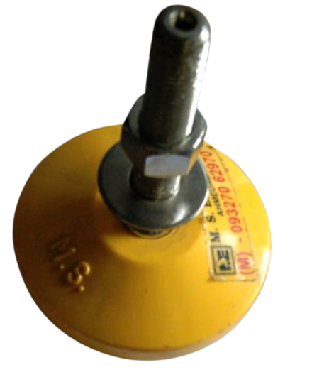
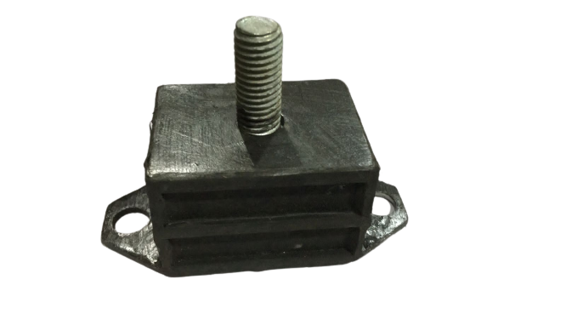
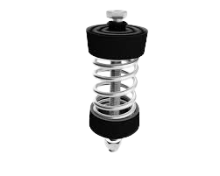
ANTI VIBRATION /
LEVELLING PADS & MACHINE / BASE MOUNTS

Slide 4
ANTI VIBRATION / LEVELLING PADS & MACHINE MOUNTS
Anti vibration rubber Mounts / Vibration Isolators are designed to reduce the level of vibration transmitted to, or from machinery and equipment. Vibration isolation mounts manufactured in rubber with a variety of bonded metal components. M. S.ENGINEERS AHMEDABD
The Design of anti vibration rubber mount is according to the application, as well as MSE is equipped to manufacture such vibration isolators and having a wide range of polymers and metal parts to bond the same.
In addition mechanical vibrations and impact stress are the biggest problems for the equipment. MSE can produce mounts to the specific vibration isolation and noise reduction systems.
Moreover, MSE can design special-purpose rubber mountings offering high deflection being able to absorb shock loads. Rubber mounts are designed for better rebound control features to reduce excess movements under shock loads.
Similarly AV mounts will lower maintenance costs and increase lifetime and reduce downtime of the machinery.
*MSE (M. S. ENGINEERS)

Slide 5
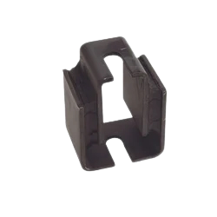
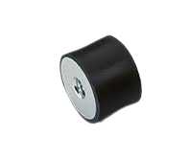
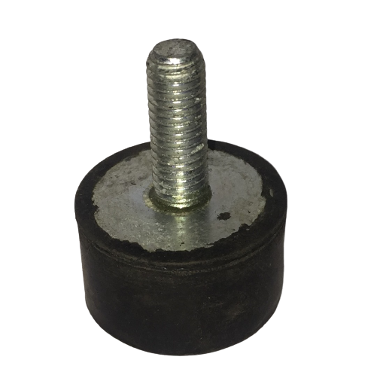
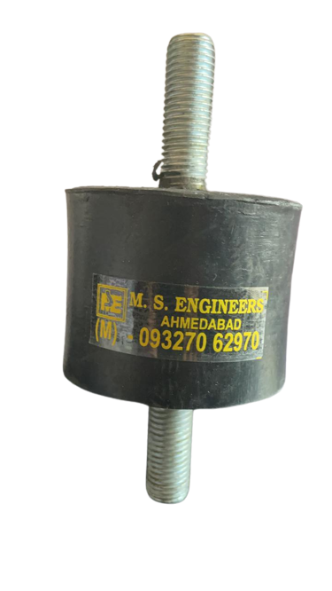
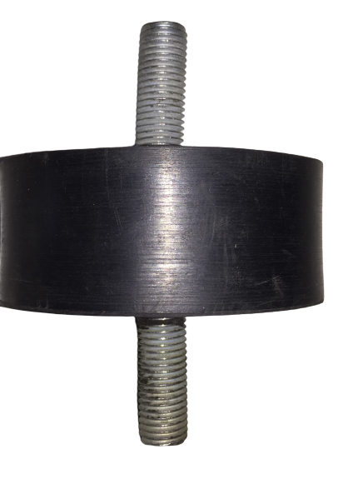
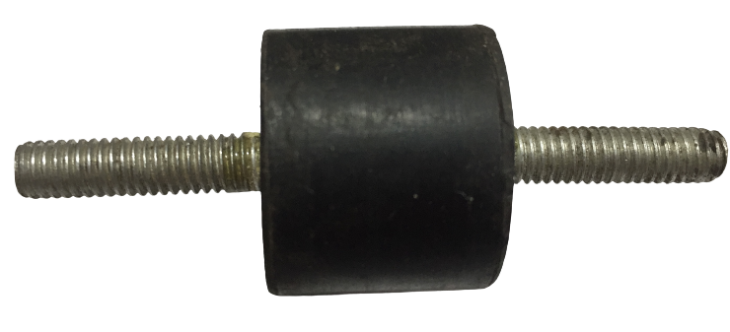
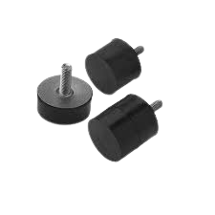
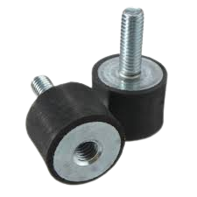
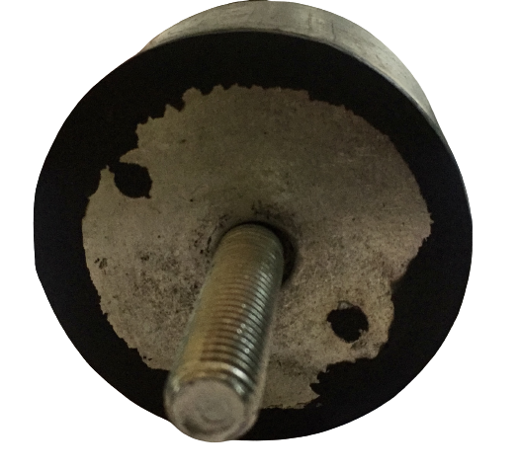
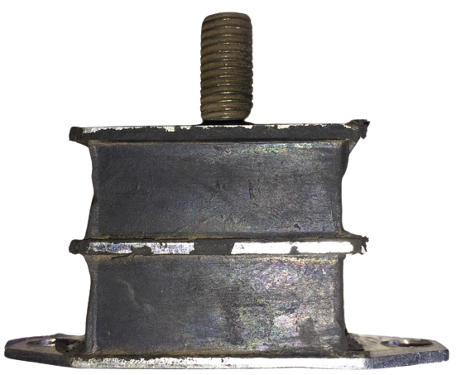
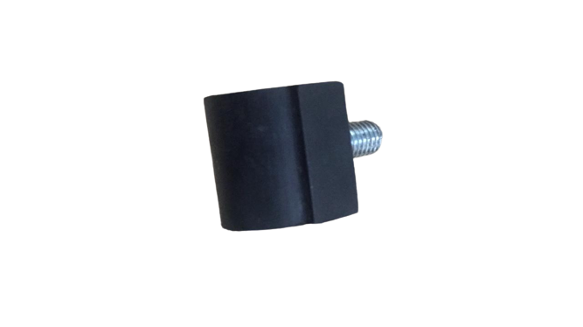
O- MOUNTS
RUBBER MOTOR PAD

Slide 6
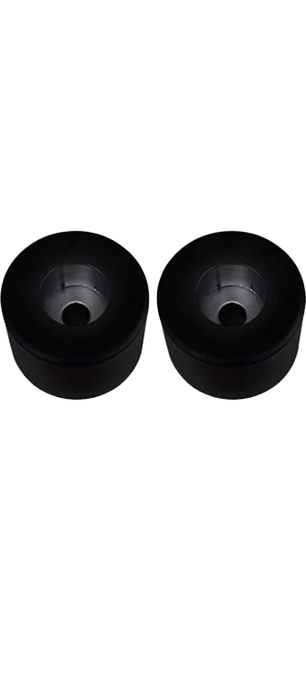
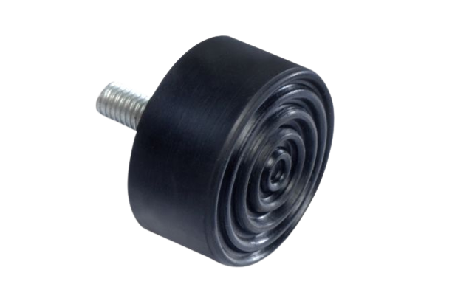
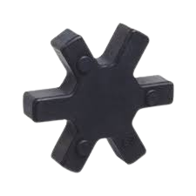
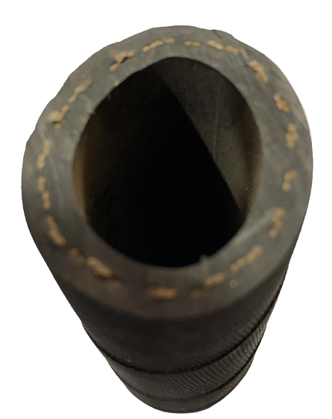
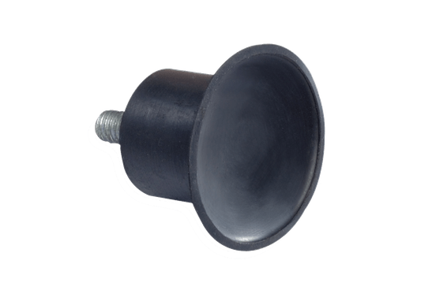
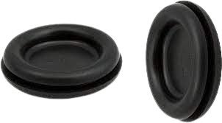
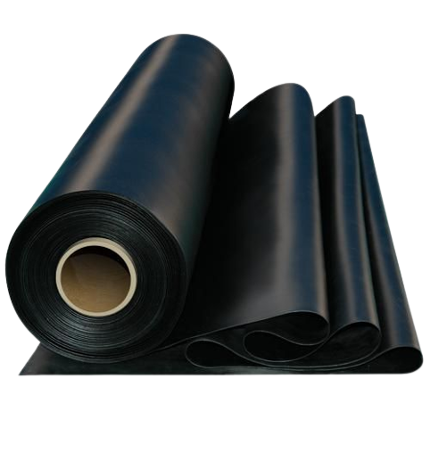
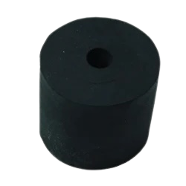
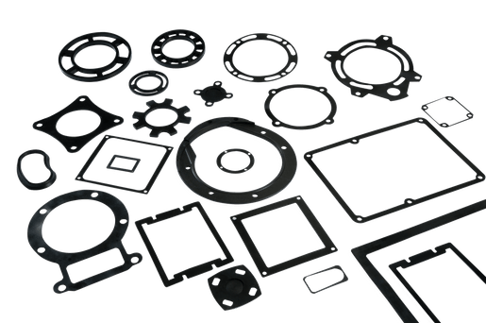
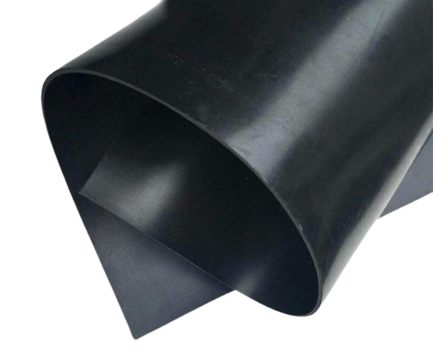
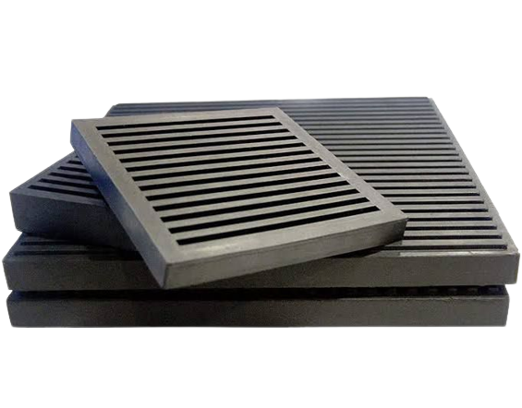
CUSTOMISED RUBBER PARTS / RUBBER GROMMETS / RUBBER GASKETS / RUBBER PADS / RUBBER SHEETS

Slide 7
R
CUSTOMISED RUBBER PRODUCTS / RUBBER O – MOUNTS
Ned close tolerance with desired chemical and physical property for a rubber part in an intricate design without compromising quality?
MSE can vouch for it because our forte is manufacturing of custom rubber moldings and We are the best at what we do.
MSE considers bespoke rubber molding parts are criticality and application dependent, hence we incorporate our strong knowledge in the chemistry behind rubber formulation and latest techniques to assure you the custom made rubber product.
MSE industry-leading technological set up for rubber molding is well equipped to manufacture any types of rubber parts in any complicated form. The molding process in MSE as follows,
» Rubber Injection molding
» Vacuum Compression molding
» Transfer molding
» Compression molding
Being one of the top custom rubber manufacturers in India, MSE also has tailor-made formulations to provide coloured custom parts.

Slide 8
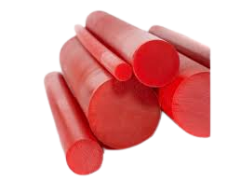
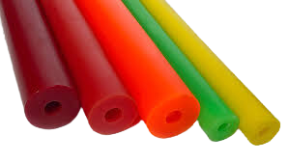
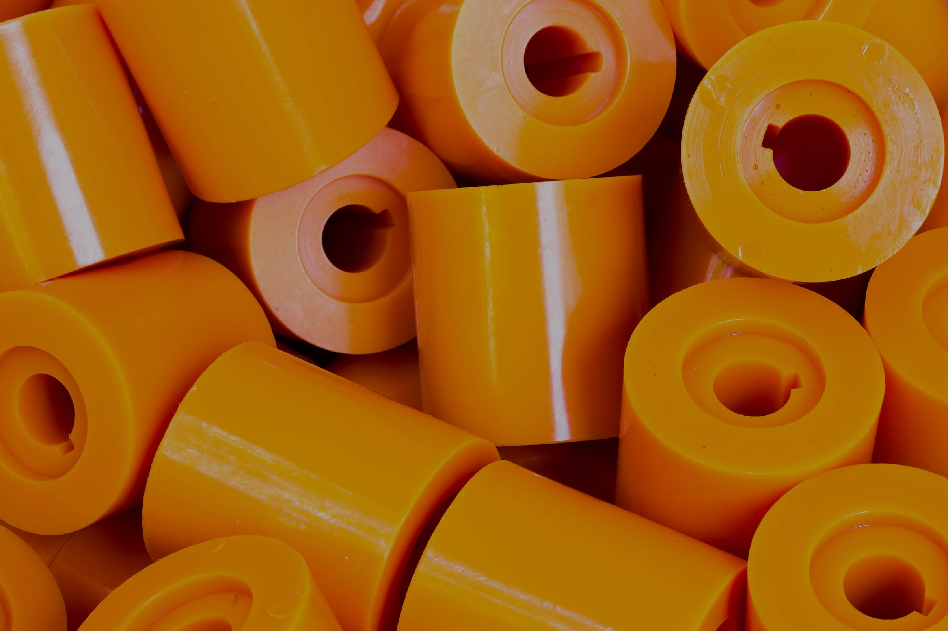
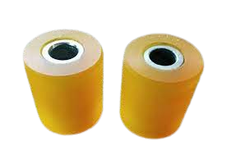
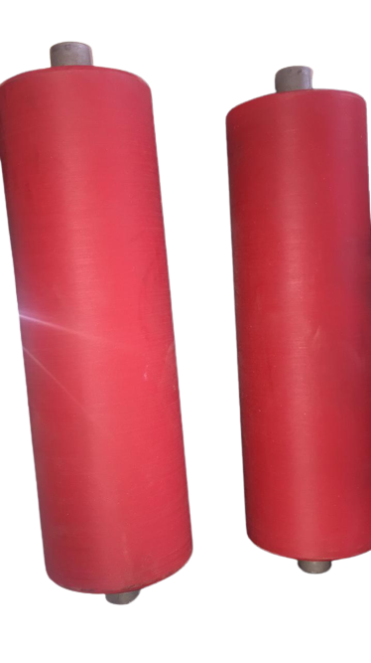
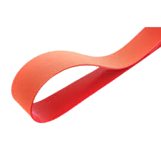
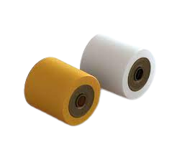
CUSTOMISED POLYURETHEANE PRODUCTS / POLYURETHEANE ROLLERS / SHEETS

Slide 9
Polyurethane formulations cover an extremely wide range of stiffness, hardness, and densities. These materials include:
Low-density flexible foam used in upholstery, bedding, automotive and truck seating, and novel inorganic plant substrates for roof or wall gardens
Low density elastomers used in footwear
Hard solid plastics used as electronic instrument bezels and structural parts
Flexible plastics used as straps and bands
Cast and injection molded components for various markets -- i.e., agriculture, military, automotive, industrial, etc.
Polyurethane bonds to a wide range of materials during the manufacturing process. These materials include other plastics, metals and wood. This property makes polyurethane an ideal material for wheels, rollers and inserts.
Polyurethane is often used to manufacture one-off parts, prototypes or high volume, repeat production runs. Size ranges vary from a couple grams to 2000lb parts.

